Slide 1
LALAMOVE Challenge
Predict the order completion probability
-Rahul Mishra (Senior Data Scientist – Reliance Industries Ltd)

Slide 2
PREFACE
From a given dataset predict the order completion probability
Here is the data that we have
Available drivers
Cancel time
Order ID
Placed Time
Reject Time
Response distance
Response Time
Service Type

Slide 3
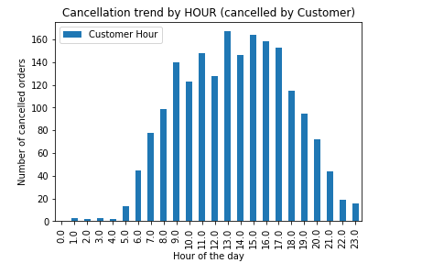
Lets do some EDA
1) Most of the canceled orders by customer were triggered between 7am – 7pm

Slide 4
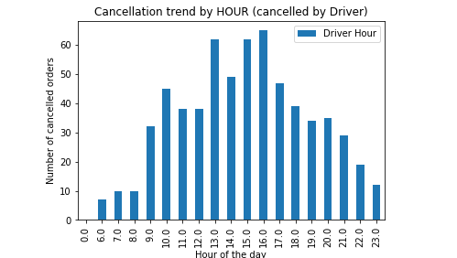
Lets do some EDA
2) Most of the canceled orders by DRIVERS were triggered between 9am – 9pm

Slide 5
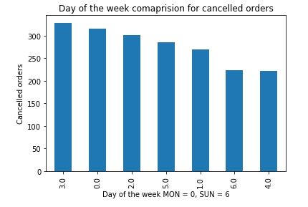
Lets do some EDA
Does the weekday has any impact on order cancellation ?? Not at all

Slide 6
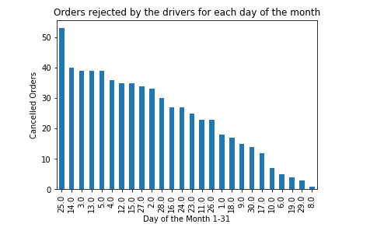
Lets do some EDA
Does day of the month (1-31) has any pattern ?
(25th day has seen the most cancellations Followed by string of dates like 12,13,14,15) safe to assume for now that there are more cancellations on second half of the month

Slide 7
#Lets do some feature engineering and dimensionality reduction
It struck me that weather might have an impact on the outcome of order completion
so I collected the weather data for HongKong from Open Weather Online for the period between June 2018 to July 2018 and mapped the weather information in the main datasheet given by LalaMove for each day

Slide 8
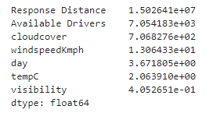
Variance
1) Upon checking the variance it was observed that Response distance and Available drivers have highest variance whereas Visibility and Temperature had the least variance

Slide 9
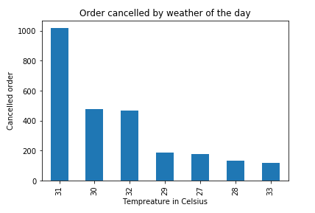
Does weather impact order cancellation
2) Upon further investigation it was observed that most of the order cancellation occured when the weather was between 30-32 degrees celsius (lets investigate further)

Slide 10
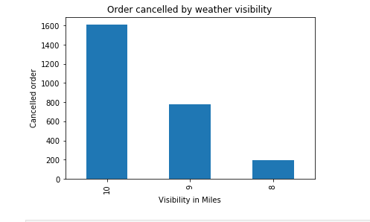
Does weather impact order cancellation
3) Does bad weather visibility impact cancellations ? its the just the opposite, since most of the cancellations occurred when the weather visibility was the best

Slide 11
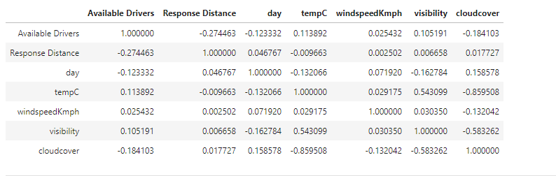
Lets check the data correlation
4) Lets check the correlation between each variables, well it turns out that Visibility and Temperature are highly corellated hence I decided to drop the visibility

Slide 12
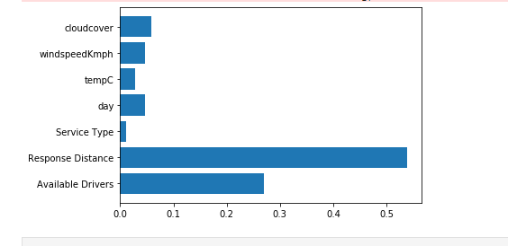
Feature importance using Random Forest
5) Finally lets check what factors heavily impact the order cancellation, turns out Response distance and available drivers play a major role in order cancellation

Slide 13
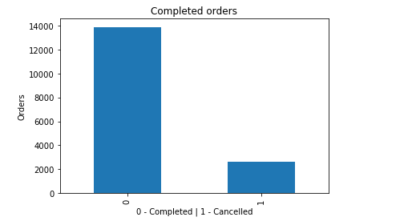
# Lets check for the data imbalance
Out of 16,500 orders roughly 14k was completed and 2.5k cancelled hence there is a huge class imbalance 14:2, we needed to get the number of cancelled orders somewhat equivalent to fulfilled orders

Slide 14
# Dealing with class imbalance
There are 2 ways out of this, oversampling and under sampling, lets try both
I used Gridsearch CV alongside SMOTE (Synthetic minority oversampling technique) to Identify how much oversampling should be done to minority class which is (order cancelled)
Then used a xgboost model to check the F1 score of the minority class
I got the following results, (on next slide)

Slide 15
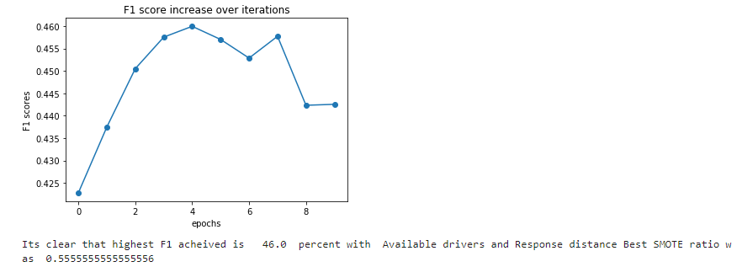
SMOTE Results
1) First I trained my model with 2 most important columns (Response distance and available drivers)
I got the following results
F1 score : 46% (suggested oversampling for minority class was 64 percent)

Slide 16
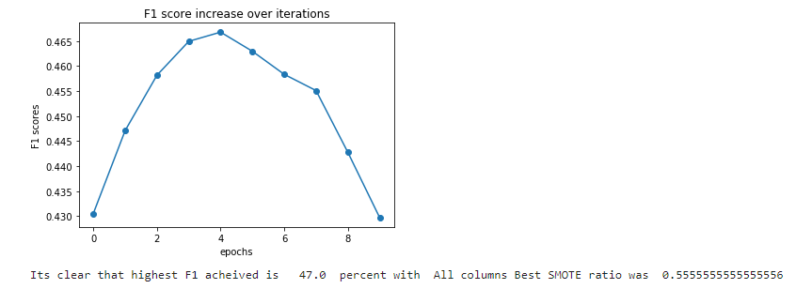
SMOTE Results
2) Then trained my model with all the columns (including newly created column post feature engineering such as Hour of the day, Temperature, windspeed, cloudcover),
F1 score was 47% for the minority class, and suggested smote ratio was 73 percent

Slide 17
#Results with oversampling
Hence I decided to use all the columns, resample with 73% ratio
and got the following classification report
precision recall f1-score support
0 0.87 0.99 0.93 4143
1 0.80 0.26 0.39 801
Accuracy 0.87 4944
macro avg 0.84 0.62 0.66 4944
weighted avg 0.86 0.87 0.84 4944

Slide 18
#Results with Undersampling
Since over sampling did not yield great results I tried undersampling with the same xgboost model and got the following results
precision recall f1-score support
0 0.63 0.88 0.74 760
1 0.81 0.52 0.63 790
Accuracy 0.69 1550
macro avg 0.72 0.70 0.68 1550
weighted avg 0.73 0.69 0.68 1550
Seems like undersampling works better for minority class compared to oversampling (ie: Predicting the cancelled orders, that is the whole point of this challenge)
Hence I decided to use the undersampling technique

Slide 19
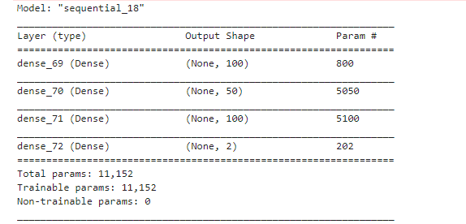
#Results with Deeplearning
Additionally I also decided to use a deep learning library Keras to check if there will be any more scope of improvement, the specification is mentioned below
Activation Function : Relu
Callbacks : Early stopping (To stop training once Validation acccuray stops improving)
PFA model summary

Slide 20
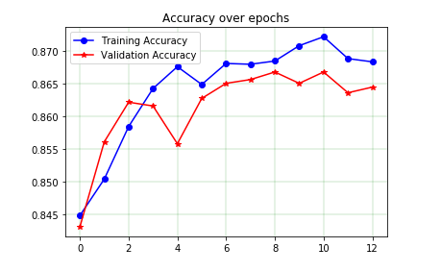
#Results with Deeplearning
Validation Accuracy : 86 %
Training accuracy : 87%
Early stopping applied to stop training once the validation accuracy stops improving hence only 12 epochs instead of 50

Slide 21
#Tips for future Improvement
Collecting reasons for the order cancellation (by customer or by driver) will play a major role,
lets say drivers cancel the order due to heavy traffic conditions or shortage of available vehicles then we can use these data for better prediction in future

Slide 22
Thanks a bunch!!

